Slide 1
Cymraeg y Tu Hwnt i’r Ysgol?
Welsh out of School?
Ffactorau’n sy’n Effeithio ar Ddefnydd Cymdeithasol Disgyblion Ysgol o’r Gymraeg
Factors Influencing School Pupils’ Social Use of Welsh
Rhai Canfyddiadau Cychwynnol
Some Early Findings
Siôn Aled Owen elp0d1@bangor.ac.uk
Dan oruchwyliaeth / Supervised by Jean Ware a Rhian Hodges

Slide 2
Crynodeb / Summary
Y cefndir i addysg cyfrwng Cymraeg Background to Welsh medium education
Y mater dan sylw: defnydd cyfyngedig o’r Gymraeg y tu hwnt i’r ystafell ddosbarth
The issue: limited social use of Welsh outside the classroom
Methodoleg / Methodology
Rhai canfyddiadau cychwynnol Some initial findings
Effaith ac Oblygiadau / Impact and Implications

Slide 3
Canran siaradwyr Cymraeg Percentage Welsh speakers 1961

Slide 4
1971

Slide 5
1981

Slide 6
1991

Slide 7
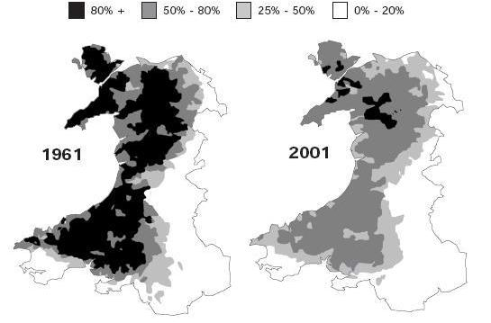

Slide 8
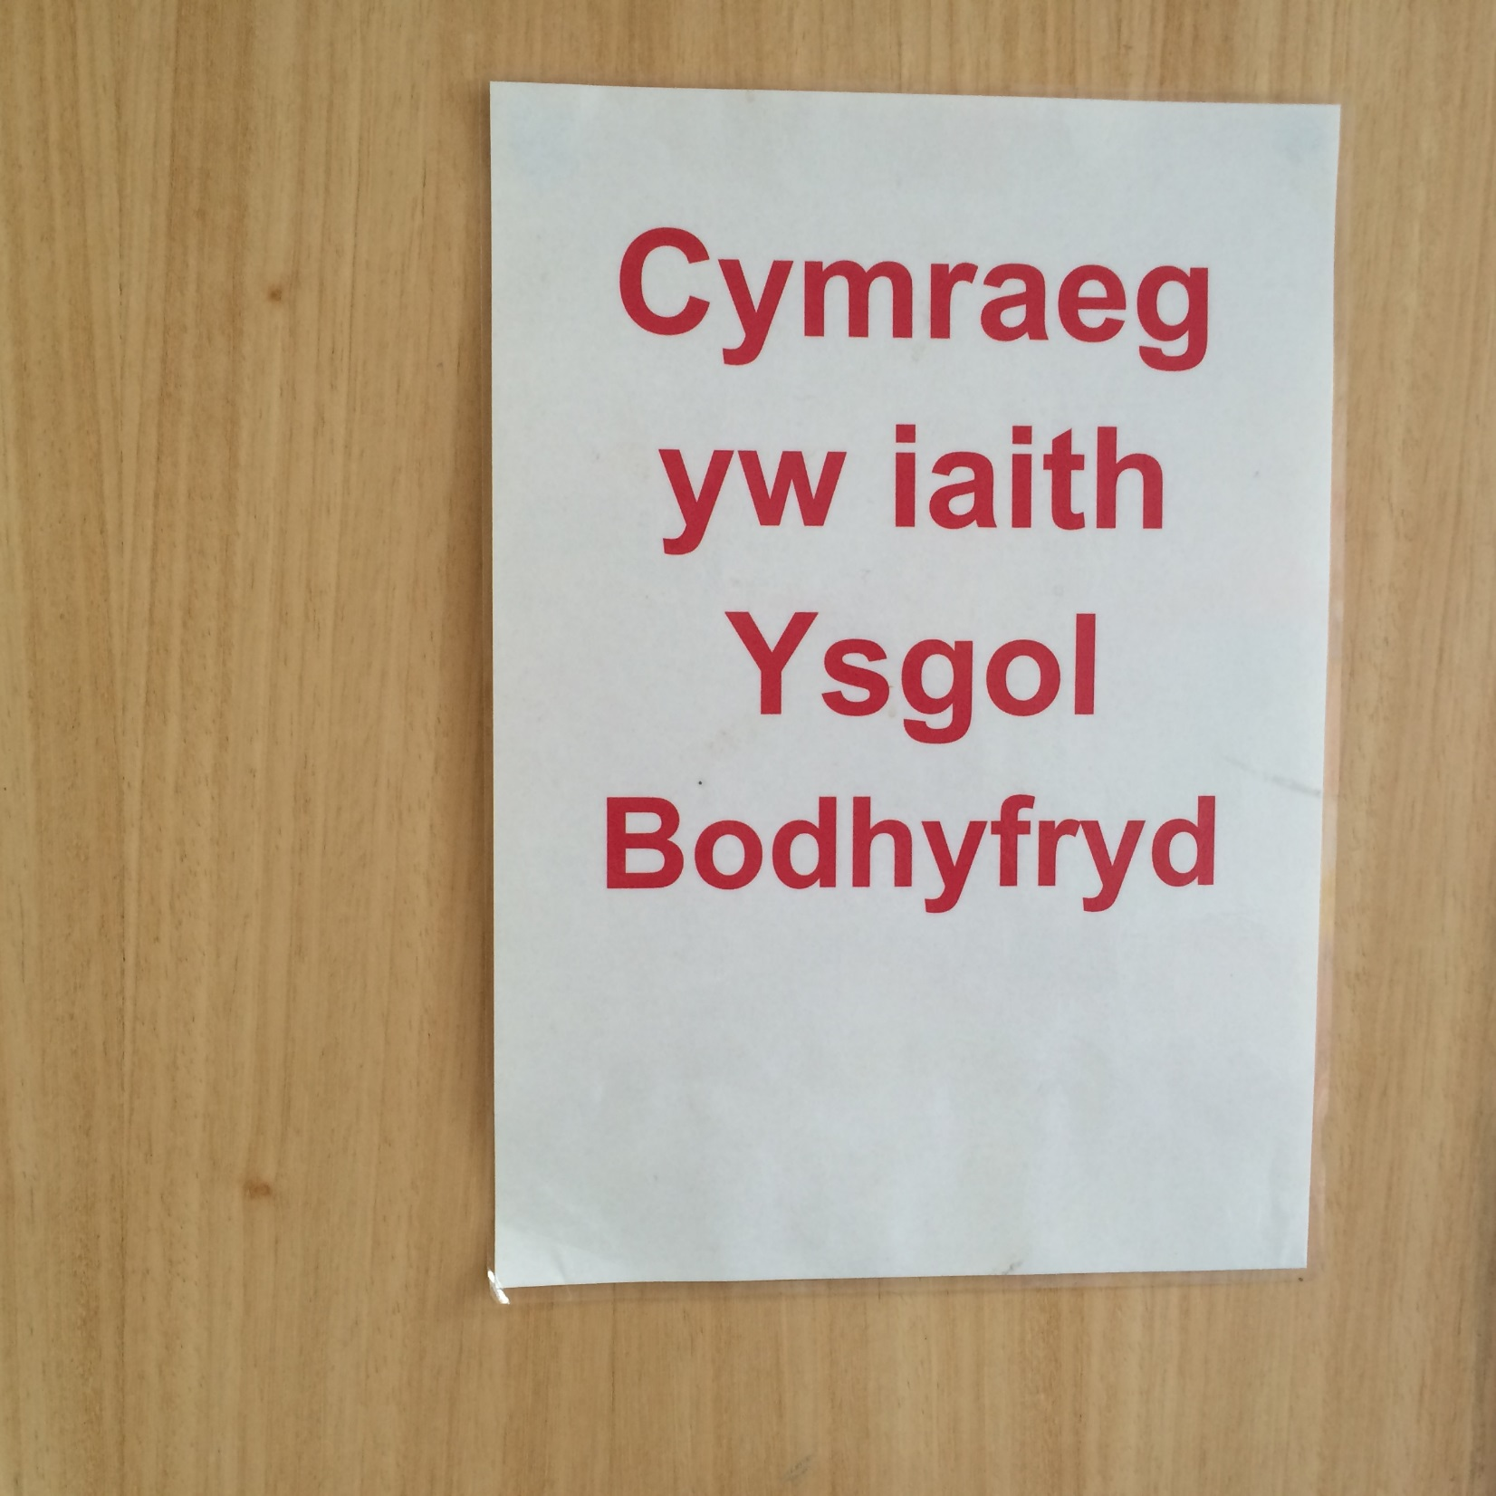

Slide 9
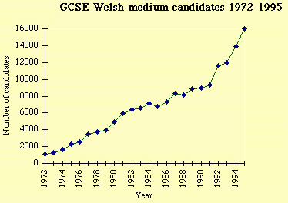
Ymgeiswyr TGAU cyfrwng Cymraeg
Welsh medium GCSE candidates 1972 - 1995
Nifer ymgeiswyr / Number of candidates
Blwyddyn / Year

Slide 10
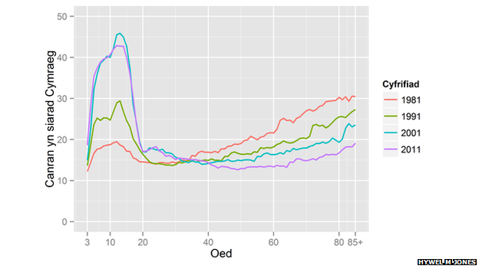
/ Census
Percentage Welsh-speaking
/ Age

Slide 11
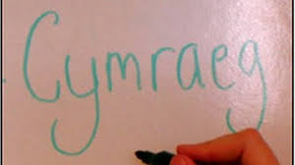
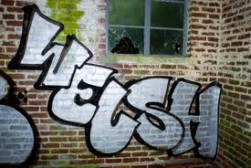
“Mae’r Gymraeg yn saff bellach, felly does dim rhaid i ni ei siarad …”
“Welsh is safe now, so we don’t need to speak it …”

Slide 12
Rhai pwyntiau o ymchwil blaenorol Some points from extant research
Tuedd gyffredinol i ffafrio’r Saesneg y tu allan i’r ysgol. General trend to favour English beyond school. (Thomas & Roberts 2011)
Y duedd honno’n gryfach lle mae’r Gymraeg yn wannach yn y gymuned. Trend stronger in areas where Welsh is weaker in the community. (Hodges 2009).
Nid yw agwedd gadarnhaol at iaith bob amser yn cydfynd â’i defnyddio. Y ffynonellau uchod ac yn arbennig Nicholas (2009) yng nghyd-destun Arizona. “I live Hopi, I just don’t speak it”. Positive attitude to a language not always reflected in use. Above sources and especially Nicholas ((2009) in the context of Arizona. “I live Hopi, I just don’t speak it”.

Slide 13
Rhai pwyntiau o ymchwil blaenorol Some points from extant research
Y sefyllfa o bosibl yn wahanol wrth gyfathrebu ar-lein. Possible variation in on-line communication. (Cunliffe et al. 2013)
Tystiolaeth yn ymddangos o ddylanwad diffyg cyfleoedd i ddefnyddio’r Gymraeg yn y gymuned, er enghraifft, ardal Rhydaman. Evidence emerging of the effect of lack of opportunities to use Welsh in the community, for example, the Ammanford area. (Hodges, Prys, Orrell, Williams & Williams 2015)
Llywodraeth Cymru’n ceisio cydgysylltu ymchwil yn y maes hwn. Welsh Government seeking to coordinate research in this field. (Lewis & Smallwood 2010)

Slide 14
Methodoleg / Methodology
Gweithio gyda phedair ysgol uwchradd a dwy ysgol gynradd yn bwydo pob un mewn gwahanol rannau o Gymru gyda chyd-destunau demograffig ac ieithyddol gwahanol, e e, siaradwyr Cymraeg <25%, 25-50%, 50-75% a 75%. Working with four secondary schools and two feeder primary schools for each in different parts of Wales and with varying demographic and linguistic context, e g, Welsh speakers <25%, 25-50%, 50-75% and 75%.

Slide 15
Methodoleg / Methodology
Holiaduron ar gyfer holl ddisgyblion Blwyddyn 6 a Blwyddyn 7, yn ceisio data meintiol ac ansoddol. Questionnaires for all Year 6 and Year 7 pupils, seeking both quantitative and qualitative data.
Holiaduron ar gyfer sampl o aelodau staff yr ysgolion – ac nid dim ond staff dysgu. Questionnaires for a sample of school staff - and not only teaching staff.

Slide 16
Methodoleg / Methodology
Holiaduron ar gyfer holl ddisgyblion Blwyddyn 6 a Blwyddyn 7, yn ceisio data meintiol ac ansoddol. Questionnaires for all Year 6 and Year 7 pupils, seeking both quantitative and qualitative data.
Holiaduron ar gyfer sampl o aelodau staff yr ysgolion – ac nid dim ond staff dysgu. Questionnaires for a sample of school staff - and not only teaching staff.

Slide 17
Grwpiau ffocws dilynol o blant – yr aelodaeth yn adlewyrchu ystod yr ymatebion. Follow-up focus groups of children – membership representative of the range of responses.
Ystyried sefyllfaoedd â rhai nodweddion tebyg dramor. Consideration of situations with some similar attributes overseas.
Mynediad i ysgolion a chydweithrediad ysgolion yn broblem. Accessing schools and schools’ cooperation an issue.

Slide 18
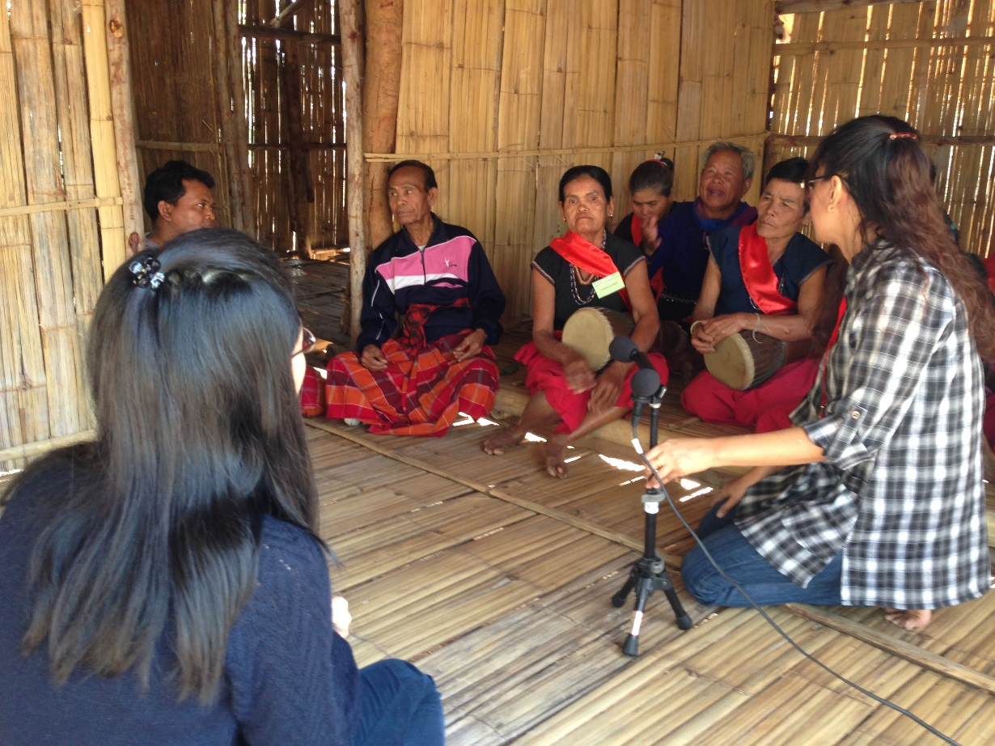
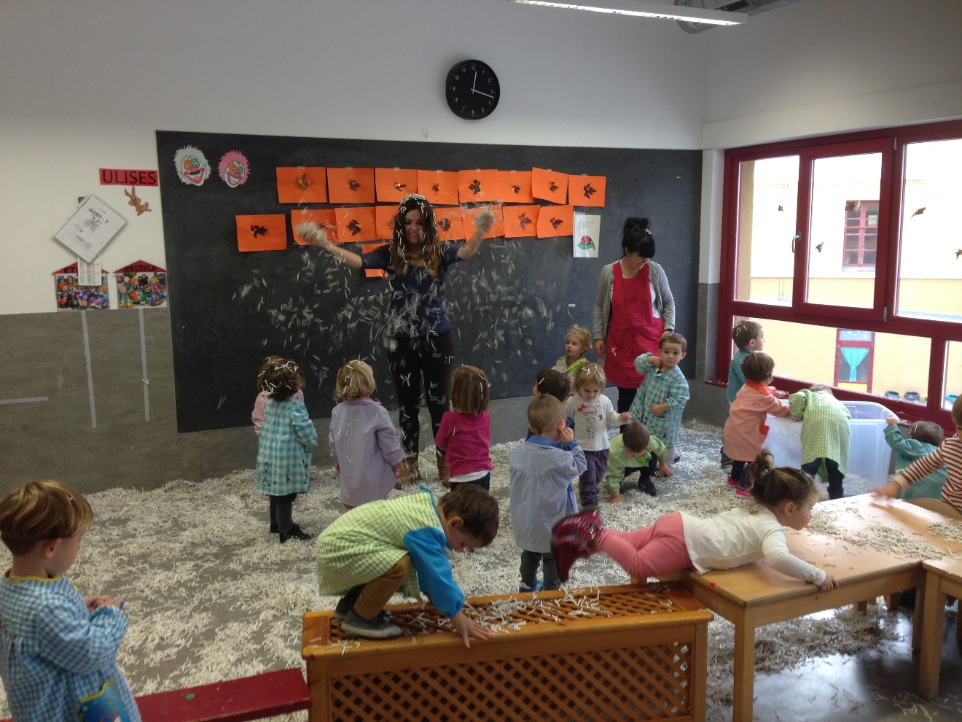

Slide 19
Rhai Canfyddiadau Cychwynnol Some Initial Findings
Dadansoddi’n parhau felly fe ystyrir yma gan fwyaf y data ansoddol yn ymwneud â disgyblion yn ysgolion y Gogledd-ddwyrain a’r De-ddwyrain (N=295). Analysis is ongoing so here consideration will be confined (mainly) to qualitative data regarding pupils in the schools in North East and South East Wales (N=295).

Slide 20
Agwedd gadarnhaol yn gyffredinol at y Gymraeg – hyd yn oed ymhlith plant sy’n dewis defnyddio’r Saesneg yn gymdeithasol. Generally positive attitude to Welsh – even among children who choose to use English socially.
Ymatebion i’r cwestiwn “Pa mor bwysig ydy hi bod y Gymraeg yn parhau’n iaith fyw?”: Cyfartaledd cyffredinol 9.1, gydag ond ychydig o wahaniaeth rhwng y Gogledd-ddwyrain (9.27) a’r De-ddwyrain (9.04) a rhwng disgyblion Blwyddyn 6 (9.32) a Blwyddyn 7 (9.03). Ychydig iawn o ddisgyblion a nododd sgôr llai na 6. Responses to the question “How important is it to you that Welsh survives as a living language?”: Overall average: 9.1, with little variation between schools in the North East (9.27) and South East (9.04) and between Year 6 (9.32) and Year 7 (9.03) pupils. Very few pupils recorded a score of below 6.
Desire to use more Welsh.

Slide 21
“Mae Cymraeg yn iaith gwych ac yn mwynhau cael ei dysgu fel iaith ail” “Welsh is a great language and enjoy getting to learn it as a second language.” (SESecm)
“Mae'r iaith gymraeg yn awesome.” “The welsh language is awesome.” (SEPri2m)
“Mae o mor bwisig i gymraeg gario ymlaen” “It’s so important for welsh to carry on” (NEPri2f)
“there is nothing cool about my experience.” (Saesneg yn y gwreiddiol / original English) (SESecm)
[Ond mwy o sylwadau negyddol, gan ddisgyblion a rhieni, yn ysgolion y Gogledd-orllewin.
But more negative comments, by pupils and parents, at North-West schools.]

Slide 22
Cefndir teuluol yn bwysig yn ôl y disgwyl – ond gallai dylanwad brodyr a chwiorydd a’r teulu estynedig fod yn fwy nag y tybid. Importance of family background as expected – but influence of siblings and extended family may be greater than has been thought. “Dwi’m yn siarad lot o gwbwl oherwydd ma mam a dad yn Saesneg.” “I don’t speak a lot [of Welsh] at all because my mum and dad are English speaking.” (NESecm)
“Ni’n siarad Cymraeg yn fan’no [gartref] oherwydd y mae y dau riant yn gallu siarad Cymraeg.” “We speak Welsh there [at home] because both parents can speak Welsh.” (SEPri2f)

Slide 23
“Mae'n profiad o ddefnyddio Cymraeg oherwydd mae fy mam yn balch fod fi yn gallu siarad Cymraeg a mae'n pleser.” (Rhieni di-Gymraeg) “It’s an experience using Welsh because my mum is proud that I’m able to speak Welsh and it’s a pleasure.” (SESecf) (Parents not Welsh-speaking)
“Siarad [Cymraeg] i fy Chwaer. A ymarfer dysgu cymraeg i fy mam.” “Speak [Welsh] to my Sister. And practise teaching welsh to my mum.” (SEPri1m)
“Dwi’n siarad yn Saesneg achos ma mam a dad fi yn Saesneg ond dwi’n siarad Cymraeg efo chwaer fi. ” “I speak in English because my mum and dad are English speaking but I speak Welsh with my sister.”(NESecf)
“... oherwedd fi a fy mrawd yn galle siarad am pethau ac a mam a dad ddim yn cael cliw.” “… because my brother and I can talk about things and mum and dad don’t have a clue.” (SESecm)

Slide 24
“Mae'n profiad o ddefnyddio Cymraeg oherwydd mae fy mam yn balch fod fi yn gallu siarad Cymraeg a mae'n pleser.” (Rhieni di-Gymraeg) “It’s an experience using Welsh because my mum is proud that I’m able to speak Welsh and it’s a pleasure.” (SESecf) (Parents not Welsh-speaking)
“Siarad i fy Chwaer. A ymarfer dysgu cymraeg i fy mam.” “Speak Welsh to my Sister. And practise teaching welsh to my mum.” (SEPri1m)
“Dwi’n siarad yn Saesneg achos ma mam a dad fi yn Saesneg ond dwi’n siarad Cymraeg efo chwaer fi. ” “I speak in English because my mum and dad are English speaking but I speak Welsh with my sister.”(NESecf)
“... oherwedd fi a fy mrawd yn galle siarad am pethau ac a mam a dad ddim yn cael cliw.” “… because my brother and I can talk about things and mum and dad don’t have a clue.” (SESecm)

Slide 25
“Dwi yn siarad Cymraeg efo nain a taid ac ddim adre.” “I speak Welsh with grandma and grandad and not at home.” (NESecm)
“Rydw i yn defnyddio'r Gymraeg tu allan i'r ysgol yn siarad gyda fy uncwl a gyda ffrindiau.” “I use Welsh outside school speaking with my uncle and with friends.” (SESecf)

Slide 26
Ymwybyddiaeth o hunaniaeth yn ffactor pwysig. Identity awareness is an important factor. “Dylsai mwy o pobol siarad Cymraeg oherwydd maen nhw’n byw yn Cymru.” “More people should speak Welsh because they live in Wales.” (NEPri2m)
“Mae yn iaith gwych ac mae'n dda os wyt yn siarad Cymraeg oherwydd rwyf efo calon cymraeg.” “It’s a great language and it’s good if you speak Welsh because I have a welsh heart.”(SESecf)
“Y Ffaith bod ni'n gwahanol ac rydym yn teimlo'n sbesial oherwydd ni'n cael yr sgil yma.” “The Fact that we’re different and we feel special because we have this skill.” (SESecf)

Slide 27
Cynigiodd 65 o’r 166 disgybl (39%) a gwblhaodd yr holiadur yn SESec sylwadau’n ymwneud â hunaniaeth / teimlo’n arbennig mewn ymateb i’r cwestiwn “A oes yna unrhyw beth arall yr hoffech chi ei ddweud am eich profiad o ddefnyddio’r Gymraeg?” 65 out of the 166 pupils (39%) who completed the questionnaire at SESec volunteered comments relating to identity / feeling special in response to the question “Is there anything else you would like to say about your experience of using Welsh?”
[Ond roedd yr agwedd hon yn llai amlwg yn ysgolion y Gogledd-orllewin.
But this aspect was less apparent at North West schools.]

Slide 28
Pryder am ddiffyg cyfleoedd i ddefnyddio’r iaith yn y gymuned. Concern about lack of opportunities to use the language in the community. “Dwi’n mynd i clwb o’r enw [enw’r clwb] pryd dwi’n dysgu i dawnsio a pethau a dwi byth yn siarad Cymraeg fan’na o herwydd dydyn nhw ddim yn deallt.” “I go to a club called [name of club] when I learn to dance and things and I never speak Welsh there because they don’t understand.” (NEPri1m)
“Fyddwn i isio gweld fel pobol yn siarad Cymraeg ar y bysus... Achos mae y y gyrrwr bus byth yn siarad Cymraeg i ni a ni’n dod mynd i ysgol Cymraeg a ma pawb ar y bus jest byth yn siarad Cymraeg.” “I would want to see like people speaking Welsh on the buses. ... Because the the bus driver never speaks Welsh to us and we come go to a Welsh language school and everyone on the bus just never speaks Welsh.”(SESecm)

Slide 29
Ymdeimlad o ymddieithrio oddi wrth y gymuned ehangach. Sense of estrangement from the wider community. “A pan ti yn siarad Cymraeg tu allan o’r ysgol, mae pobol yn rhoi ti fel yn looks mwya od erioed [plant eraill yn chwerthin] ... So dwi ddim yn hoffi siarad tu allan.” “And when you speak Welsh outside of school, people give you like the most odd looks ever [other children laugh] … So I don’t like to speak outside.” (SEPri2f)
“Rai wythnosau nôl roedd fy chwaer fi’n siarad â cefnder fi a chwaer fi’n dechrau yn siarad Cymraeg a wedyn roedd fy cefnither fi’n jest dweud iddyn nhw stopo.” “Some weeks ago my sister was talking to my male cousin and my sister started off speaking Welsh and then my female cousin just told them to stop.” (SESecm)

Slide 30
“Pan dwi’n mynd allan ar y stryd dwi’n siarad Cymraeg efo mam oherwydd ym pan ni’n mynd i siop bach ym pan mae pobl yn clywed ym ni’n siarad Cymraeg maen nhw’n mynd fel ‘Welshies, Welshies’.” “When I go out on the street I speak Welsh with mum because um when we go to a little shop um when people hear um us speaking Welsh they go like “Welshies, Welshies’.”(SESecm)

Slide 31
Dylanwad y sector cyfrwng Saesneg. Influence of English medium sector. “Dwi’n meddwl mae’r ysgolion Saesneg yn dysgu mewn Cymraeg a dyn nhw mond cael awr yr wythnos a os dyn nhw am siarad Cymraeg yna fel dylen nhw cael mwy o cyfle i siarad Cymraeg.” “I think that the English language schools teach in Welsh and they only have an hour a week and if they want to speak Welsh then like they should have more of an opportunity to speak Welsh.” (SESecf)
“Ffrindiau fi [yn canfod bod] ni’n mynd i ysgol Cymraeg a nhw’n dweud ‘Oh, how can you do that?’ a ‘ti mor naturiol’.” ““My friends [find that we] go to a Welsh school and they say ‘Oh. how can you do that?’ and ‘You’re so natural’.” (SEPri2m)

Slide 32
“Mae rhai o ffrindiau fi’n gofyn i fi siarad Cymraeg trwy’r amser a maen nhw jest yn fel maen nhw jest yn shocd weithiau a maen nhw isio dysgu fe hefyd.” “Some of my friends ask me to speak Welsh all the time and they’re just like they’re just shocked sometimes and they want to learn it as well.” (NESecf)

Slide 33
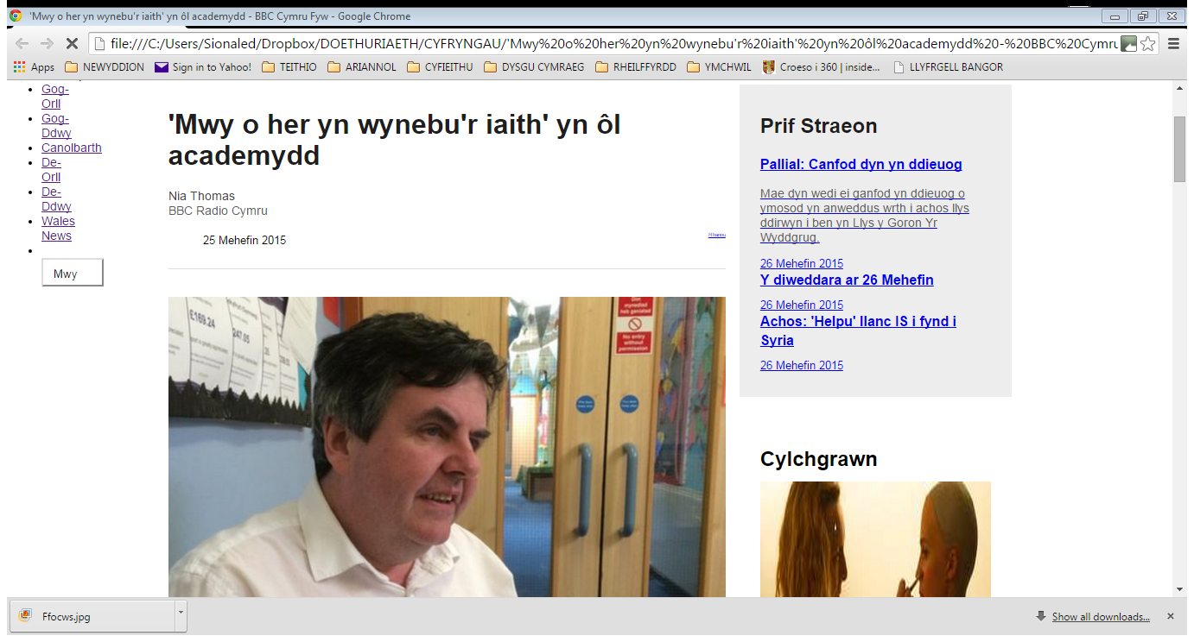

Slide 34
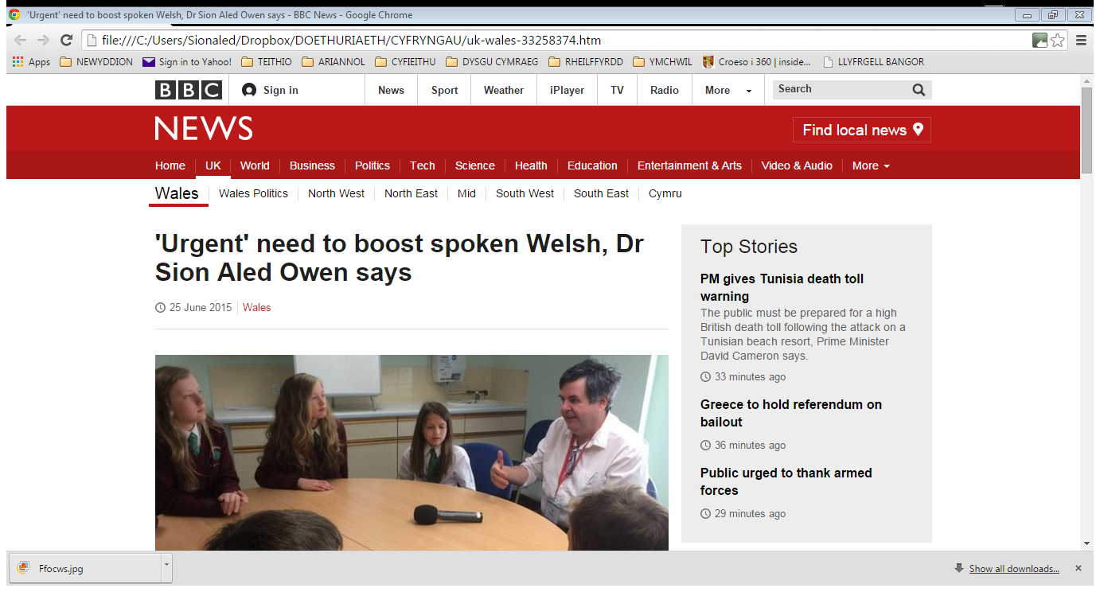

Slide 35
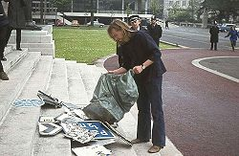

Slide 36
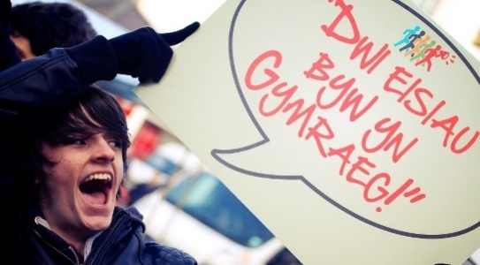

Slide 37
Llyfryddiaeth / Bibliography
Aldekoa, J. & N. Gardner 2002. Turning Knowledge of Basque into Use: Normalisation Plans for Schools. International Journal of Bilingual Education and Bilingualism 6, 339-354.
Crystal, D. 2000. Language Death. Cambridge: Cambridge University Press.
Darnton, A. Undated. GSR Behaviour Change Knowledge Review - Overview of Behaviour Change Models and their Uses. Briefing Note for Policy Makers. London: Government Social Research.
Edwards, V. & L. Newcombe 2005. When school is not enough: New initiatives in intergenerational language transmission in Wales. International Journal of Bilingual Education and Bilingualism 8, 298-312.
Evas, J., D. Mac Giolla Chríost & C. Williams 2014. A Review of the Work of Mentrau Iaith, Language Action Plans and the Language Action Plans and the Aman Tawe Language Promotion Scheme Language Promotion Scheme Language Promotion Scheme. Cardiff: Cardiff University

Slide 38
Fishman, J. 1991. Reversing Language Shift. Clevedon: Multilingual Matters Ltd.
Fishman, J. 1996. What do you lose when you lose your language? In G. Catoni (ed.) Stabilizing Indigenous Languages. Flagstaff: Center for Excellence in Education, Northern Arizona University.
Gardner, N. & M. Zalbide 2005. Basque Acquisition Planning. International Journal of the Sociology of Language 174, 55-72.
Gorter, D. 2014. Multilingualism: teaching though understanding but without speaking: the case of Basque (and Frisian). Presentation at the Coleg Cymraeg International Conference, Cardiff, July 2014.
Hodges, Rh. 2009. Welsh Language Use Among Young People in the Rhymney Valley’. Contemporary Wales 22, 16-35.

Slide 39
Hodges, Rh. C. Prys, A. Orrell, S. Williams & E. Williams 2015. Welsh Language Use in the Community. A research study undertaken as part of the Evaluation of the Welsh Ministers' Welsh Language Strategy: A living language: a language for living. Cardiff: Welsh Government.
Lewis, G. & J. Smallwood 2010. Reversing Language Shift. How to Reawaken a Language Tradition. Paper given at FEL XIV, the Foundation for Endangered Languages Conference, Carmarthen, September 2010
Lewis, G. & J. Smallwood 2011. Pobl Ifanc: Ymbweru er mwyn Gweithredu. Unpublished paper.
Lewis, W. 2008. Current challenges in bilingual education in Wales. AILA Review 21, 69-86
Newcombe, L. 2007. Social Context and Fluency in L2 Learners – The Case of Wales. Clevedon: Multilingual Matters Ltd.
Nicholas, S. 2009. “I Live Hopi, I Just Don’t Speak It” – The Critical Intersection of Language, Culture and Identity in the Lives of Contemporary Hopi Youth. Journal of Language, Identity and Education 8, 321-334.

Slide 40
Thaler, R. & C. Sunstein 2008. Nudge: Improving Decisions about Health, Wealth, and Happiness. New Haven, CT: Yale University Press.
Thomas E., D. Appolloni & G. Lewis 2013. The learner’s voice: exploring bilingual children’s selective language use and perceptions of minority language competence. Language and Education 2013, 1-22.
Thomas, E. & D. Roberts. 2011. Exploring bilinguals’ social use of language inside and out of the minority language classroom. Language and Education 25, 89‑108.
Williams, D. (producer) 2010. The Welsh Knot. Television programme broadcast on BBC Wales, 24 October 2010.

Slide 41
Siôn Aled Owen elp0d1@bangor.ac.uk
Diolch yn fawr
Many thanks

